Slide 1
Python Decision Making Loops
Python If Statements:
The Python if statement is a statement which is used to test specified condition. We can use if statement to perform conditional operations in our Python application.
The if statement executes only when specified condition is true. We can pass any valid expression into the if parentheses.
There are various types of if statements in Python.
if statement
if-else statement
nested if statement
Python If Statement Syntax:
if(condition):
statements

Slide 2
Python If Statement Example:
a=10
if a==10:
print "Welcome to Cromacampus“
Python If Else Statements
The If statement is used to test specified condition and if the condition is true, if block executes, otherwise else block executes.
The else statement executes when the if statement is false.
Python If Else Syntax:
if(condition): False
statements
else: True
statements
year=2000
if year%4==0:
print "Year is Leap"
else:
print "Year is not Leap"

Slide 3
Python Nested If Else Statement
In python, we can use nested If Else to check multiple conditions. Python provides elif keyword to make nested If statement.
This statement is like executing a if statement inside a else statement.
Python Nested If Else Syntax:
If statement:
Body
elif statement:
Body
else:
Body
Python Nested If Else Example
a=10
if a>=20:
print "Condition is True"
else:
if a>=15:
print "Checking second value"
else:
print "All Conditions are false"

Slide 4
For Loop
Python for loop is used to iterate the elements of a collection in the order that they appear. This collection can be a sequence(list or string).
Python For Loop Syntax
for <variable> in <sequence>:
Python Example to Find Sum of 10 Numbers
sum=0
for n in range(1,11):
sum+=n
print sum
Output:
55

Slide 5
Python Nested For Loops
Loops defined within another Loop are called Nested Loops. Nested loops are used to iterate matrix elements or to perform complex computation.
Python Nested For Loop Syntax:
for <expression>:
for <expression>:
Body
Python Nested For Loop Example
for i in range(1,6):
for j in range (1,i+1):
print i

Slide 6
Python While Loop
In Python, while loop is used to execute number of statements or body till the specified condition is true. Once the condition is false, the control will come out of the loop.
while <expression>:
Body
a=10
while a>0:
print "Value of a is",a
a=a-2
print "Loop is Completed"
Output:
>>>
Value of a is 10
Value of a is 8
Value of a is 6
Value of a is 4
Value of a is 2
Loop is Completed
>>>

Slide 7
Python Break
Break statement is a jump statement which is used to transfer execution control. It breaks the current execution and in case of inner loop, inner loop terminates immediately.
Python Break Example 1
for i in [1,2,3,4,5]:
if i==4:
print "Element found"
break
print i,
Output:
>>>
1 2 3 Element found
>>>

Slide 8
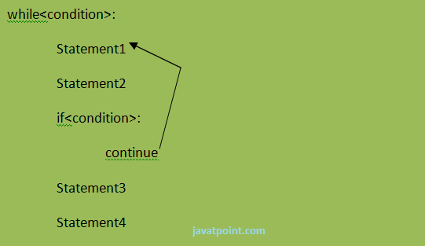
Python Continue Statement
Python Continue Statement is a jump statement which is used to skip execution of current iteration. After skipping, loop continue with next iteration.

Slide 9
Python Continue Statement Example
a=0
while a<=5:
a=a+1
if a%2==0:
continue
print a
print "End of Loop"
Output:
>>>
1
3
5
End of Loop
>>>

Slide 10
Python Pass
In Python, pass keyword is used to execute nothing; it means, when we don't want to execute code, the pass can be used to execute empty. It is same as the name refers to. It just makes the control to pass by without executing any code. If we want to bypass any code pass statement can be used.
Python Pass Syntax
pass
Python Pass Example
for i in [1,2,3,4,5]:
if i==3:
pass
print "Pass when value is",i
print i,
Output:
>>>
1 2 Pass when value is 3
3 4 5
>>>

